Slide 1
Invasive pests in the Rotorua lakes
Paul Champion and Tracey Burton

Slide 2
Overview
Rotorua lakes pre-invasion
What are the current pests?
Where are they?
What are their impacts?
How do they spread?
Proactive management

Slide 3
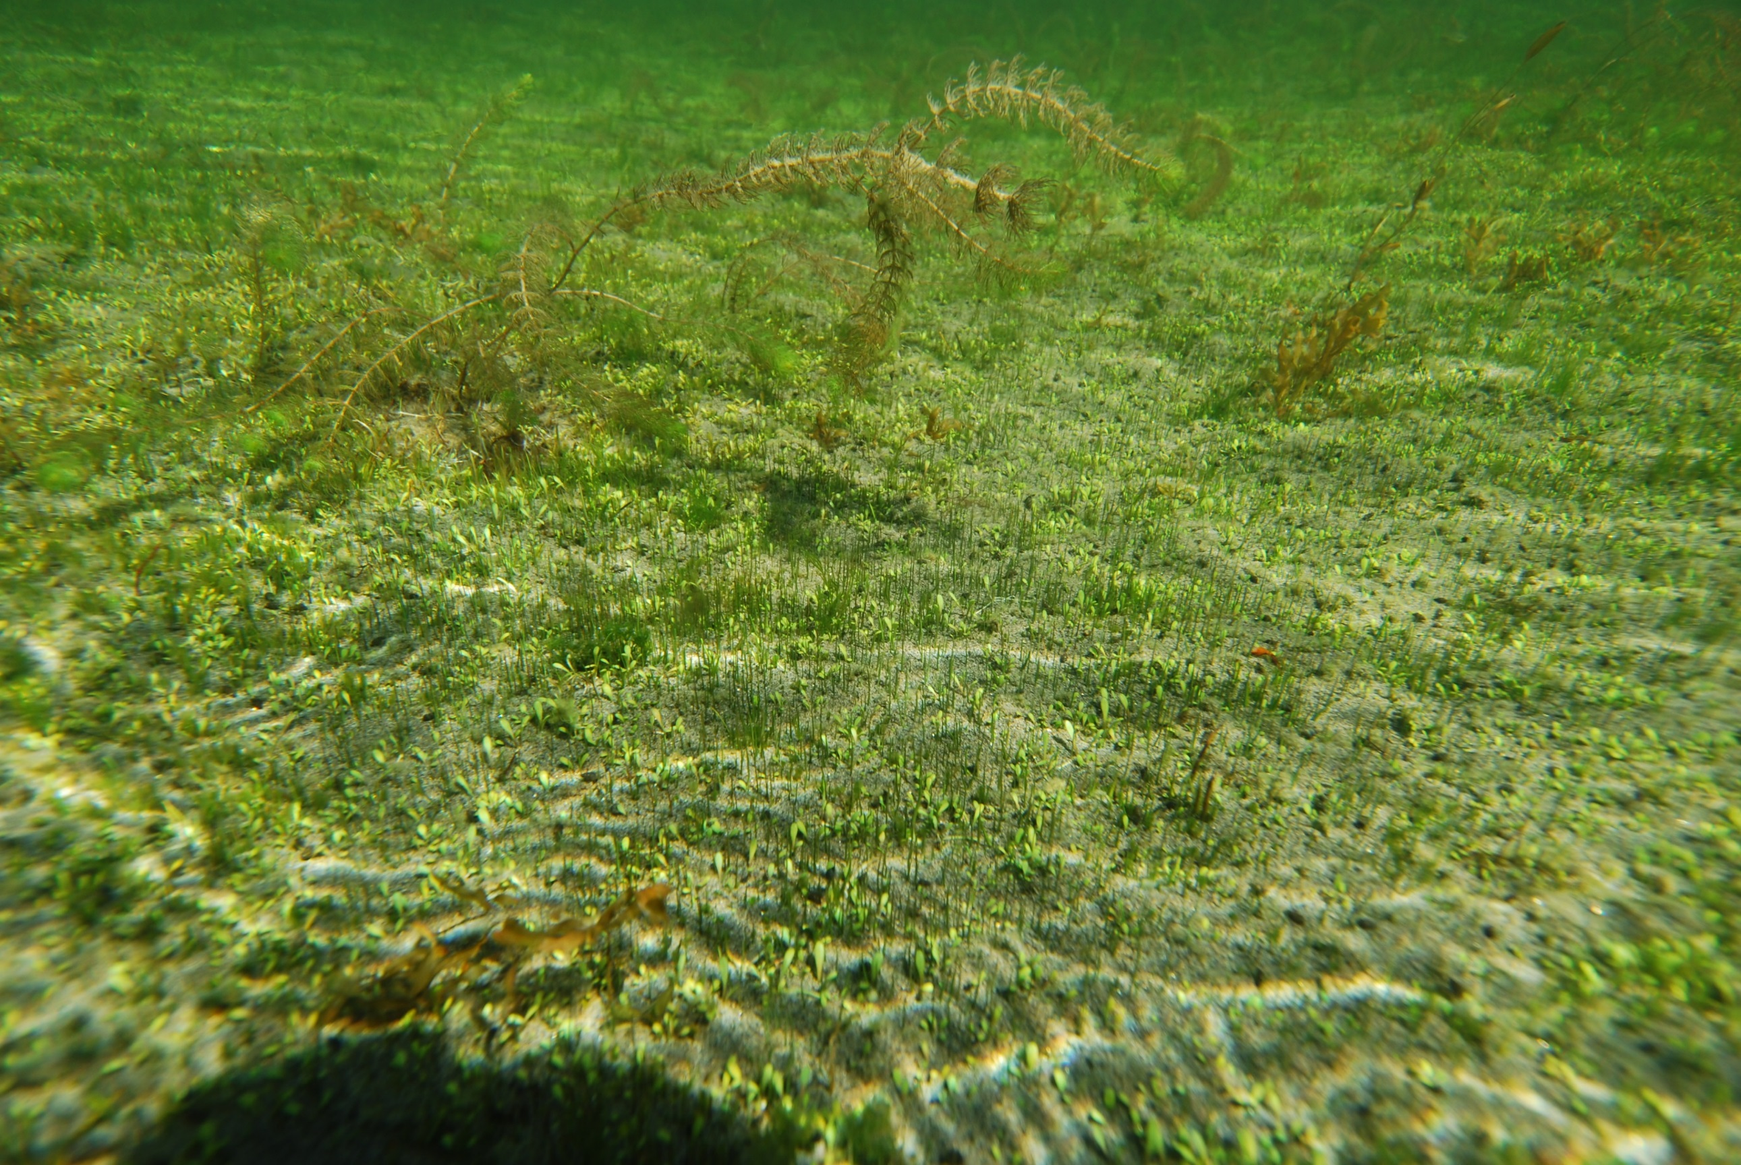
Notes:
There are ~ Twenty six turf species, all morphologically similar (knife, fork and spoon). Deborah Hofstra will be looking at this community in more detail.
LMC forms a carpet that binds the sediment together and can tolerate short-term exposure out of the water that may result from changes in water level.

Slide 4
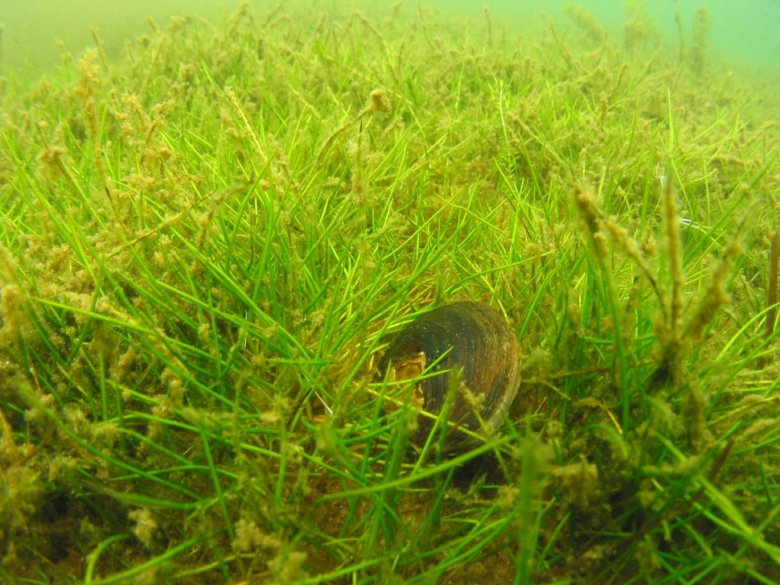

Slide 5
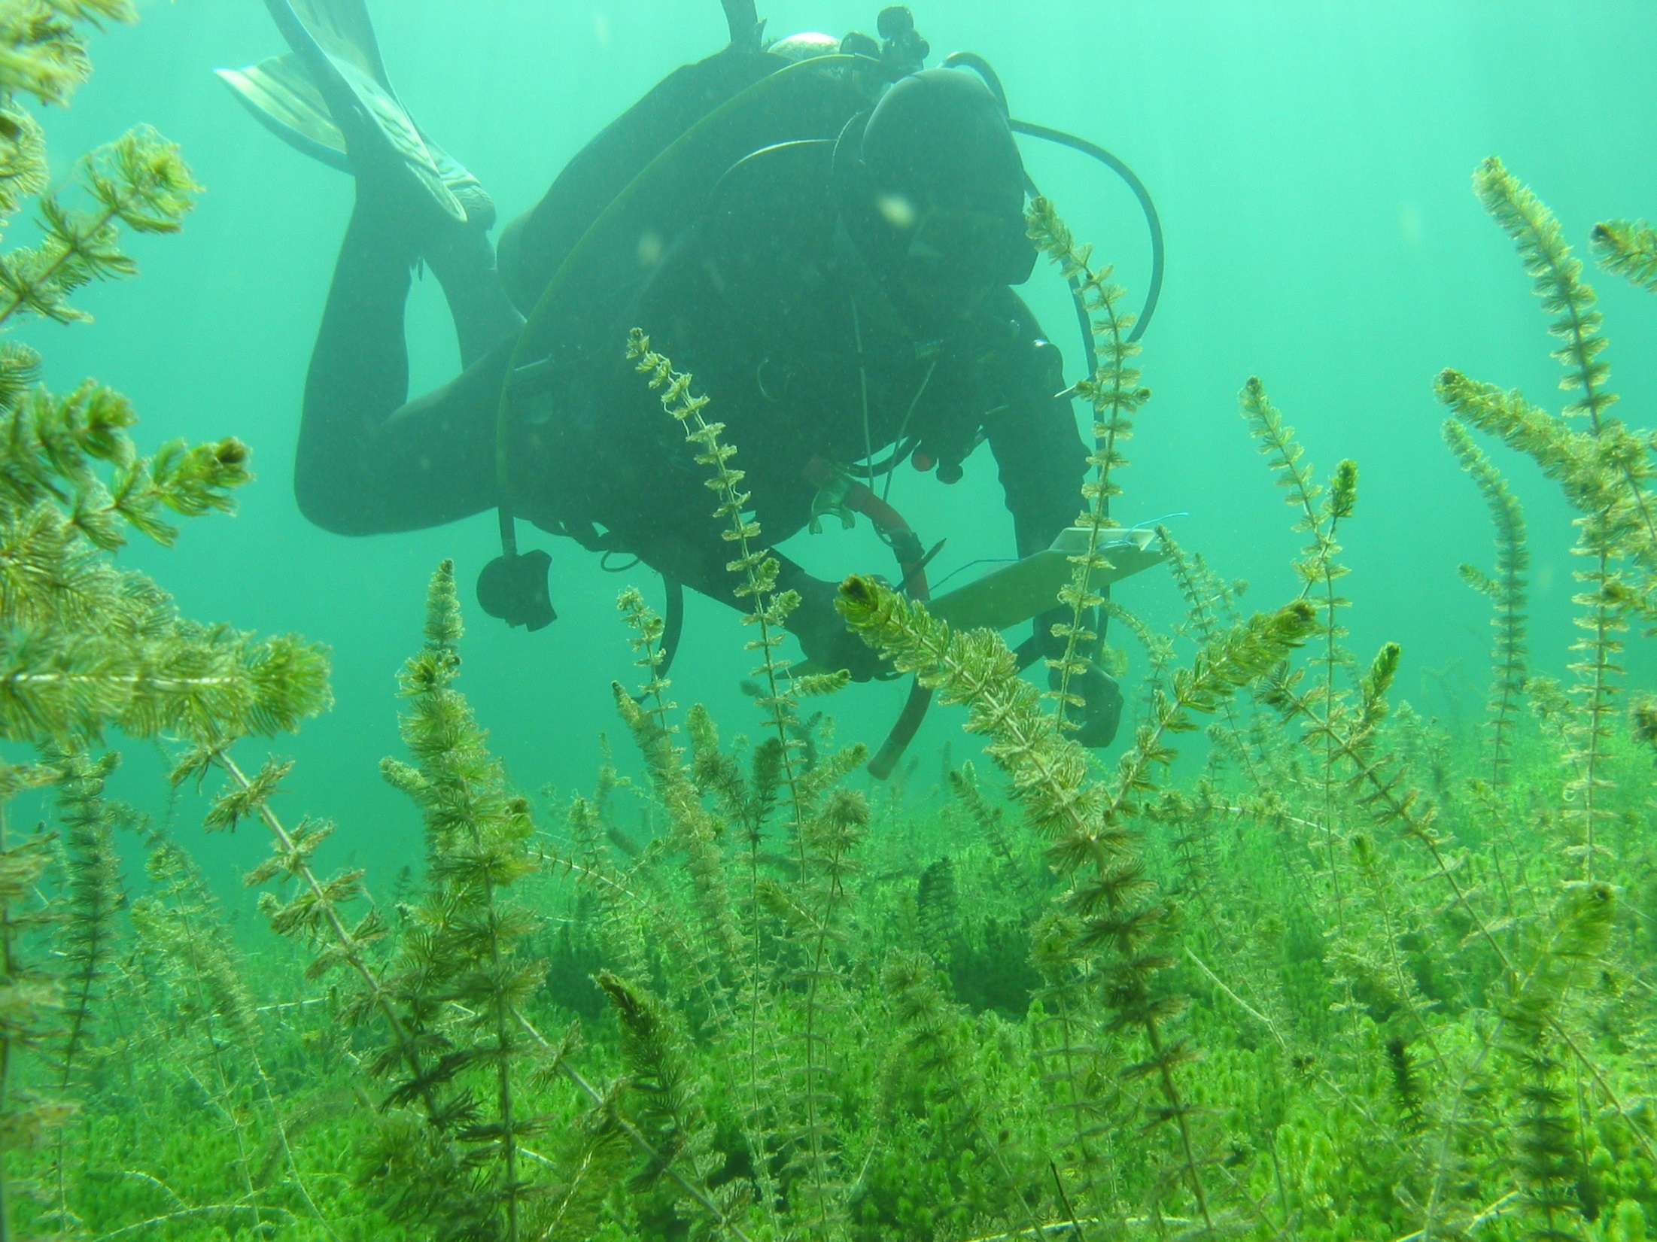

Slide 6
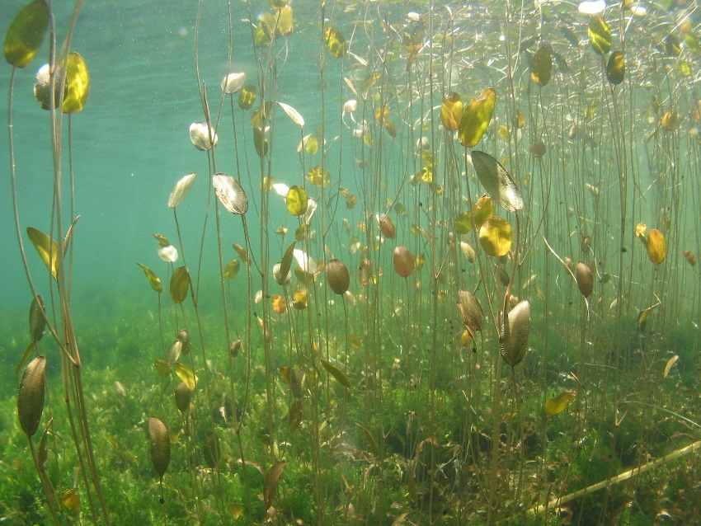
Potamogeton cheesemanii
Notes:
Next (~1m) we will need to start swimming. Growing up towards the surface you will see some taller growing plants – our native tall plant community which includes the Milfoil and Potamogeton species. Note these tall native plants are not problematic, will often be growing among other plants (turf or charophyte communities), have an open density and allow high light penetration.

Slide 7
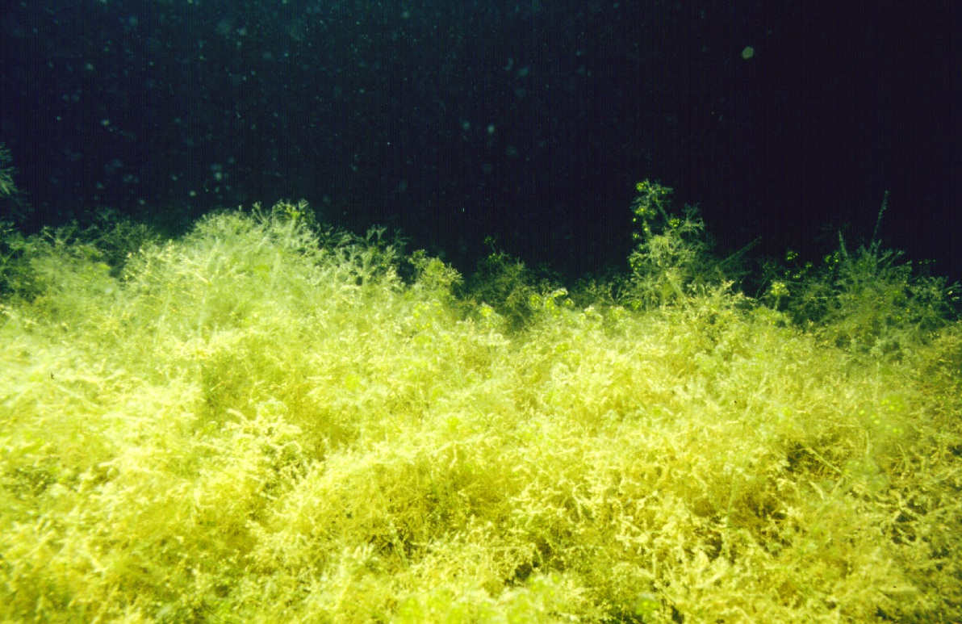
Notes:
Swimming further down the depth profile we will find the charophytes. Charophytes are in fact macro-algae and are closely related to land plants. They form attractive dense meadows, up to 1 m high and are a very important plant community in lake ecosystems.

Slide 8
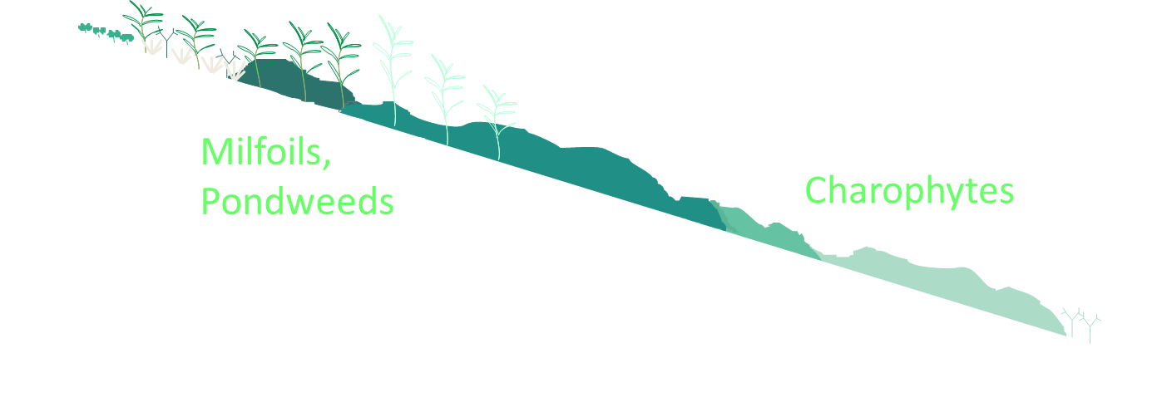
1. Rotorua lakes: pre-invasion
Lake Tarawera – pre 1930’s (based on Wells et al. 1997)

Slide 9
de Winton et al. (2017)
Notes:
Introduce LakeSPI

Slide 10
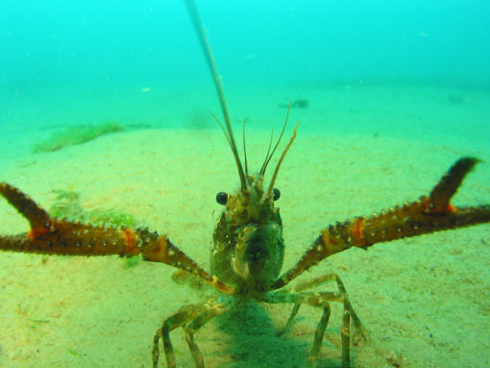
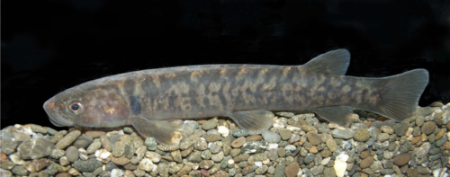
1. Rotorua lakes: pre-invasion
Kōaro Kākahi Kōura

Slide 11
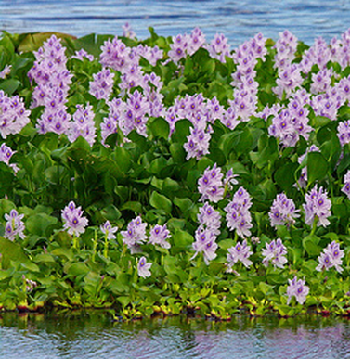
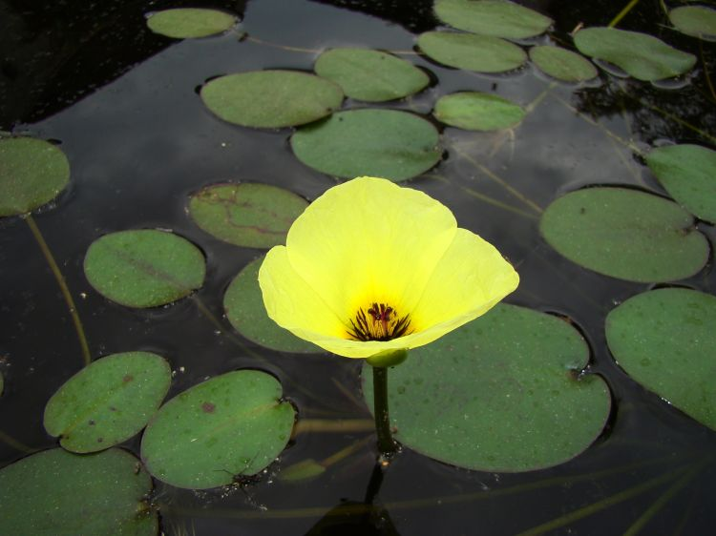
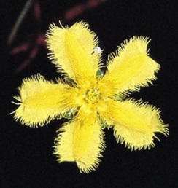
2. Rotorua lakes - introduced species
Water hyacinth (1950) Water poppy (1976) Marshwort (1981)

Slide 12
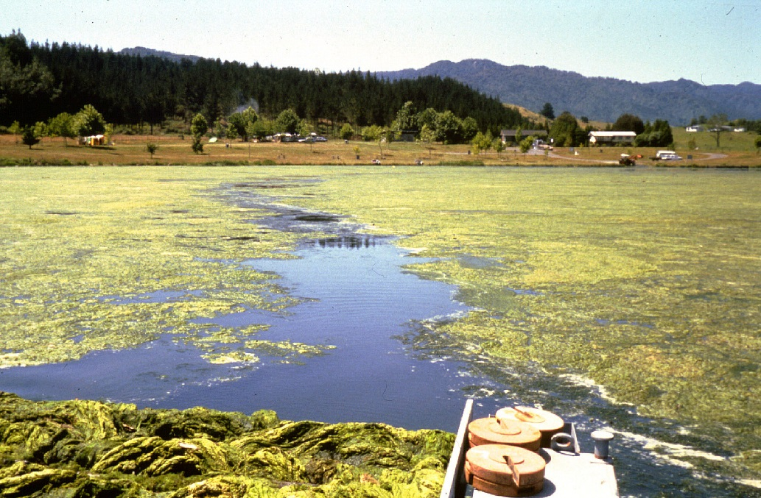
2. Rotorua lakes - introduced species
Water net (Hydrodictyon reticulatum) (1989)

Slide 13
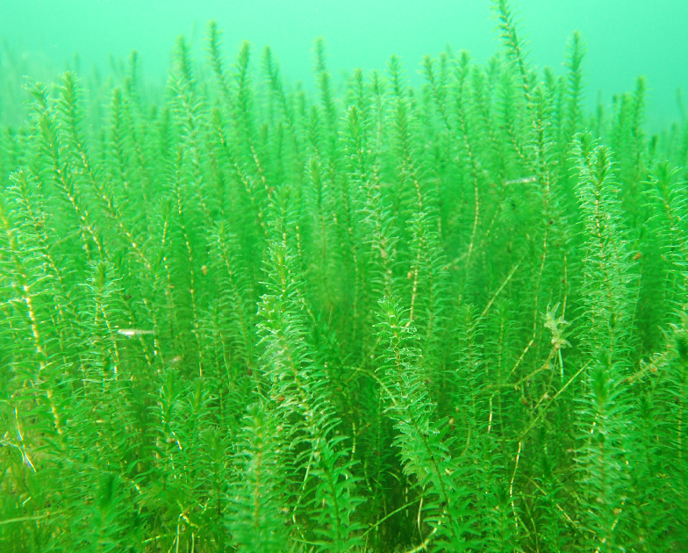
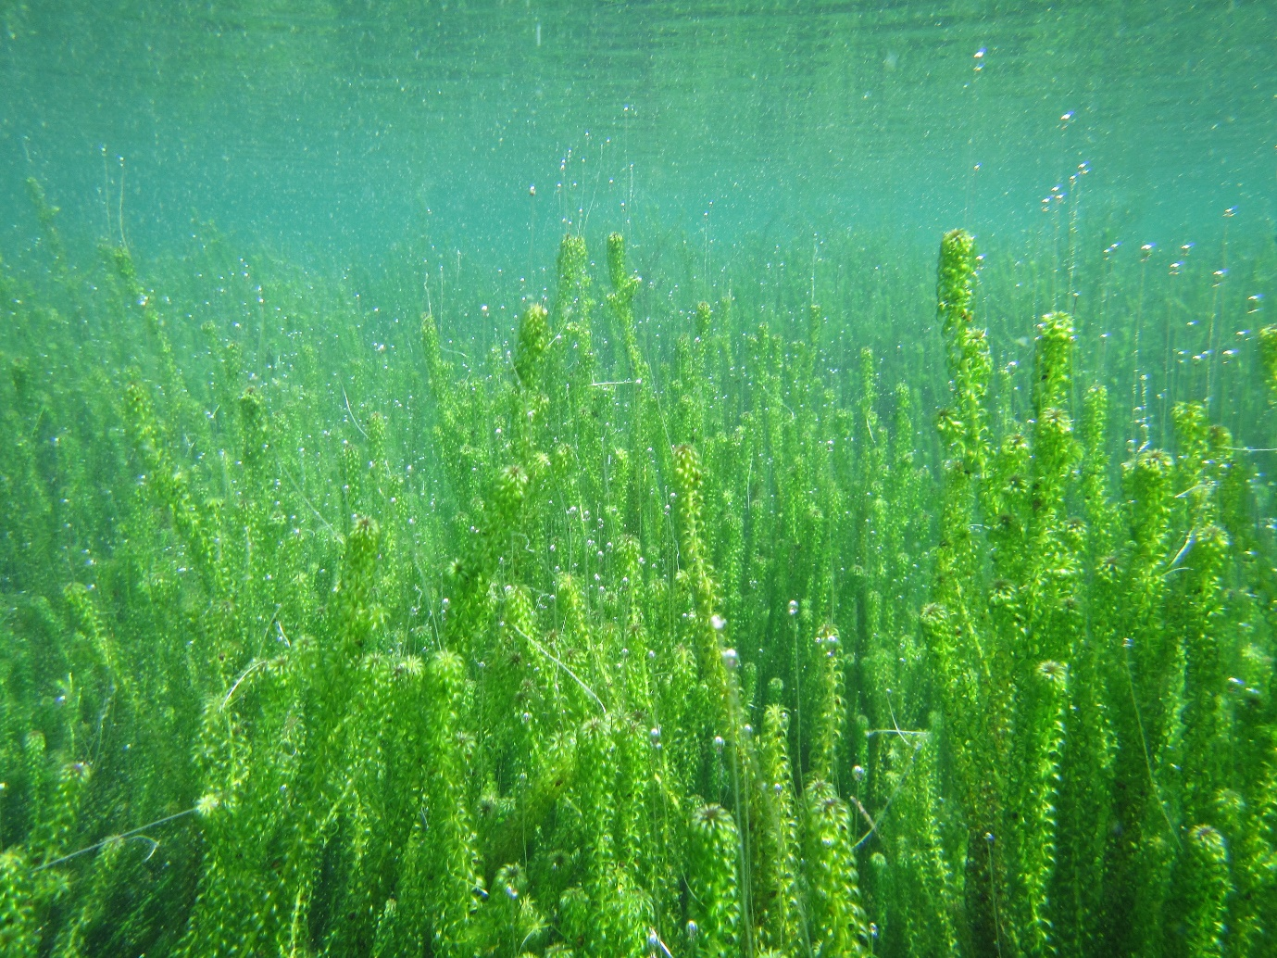
2. Rotorua lakes - introduced species
Elodea Lagarosiphon

Slide 14
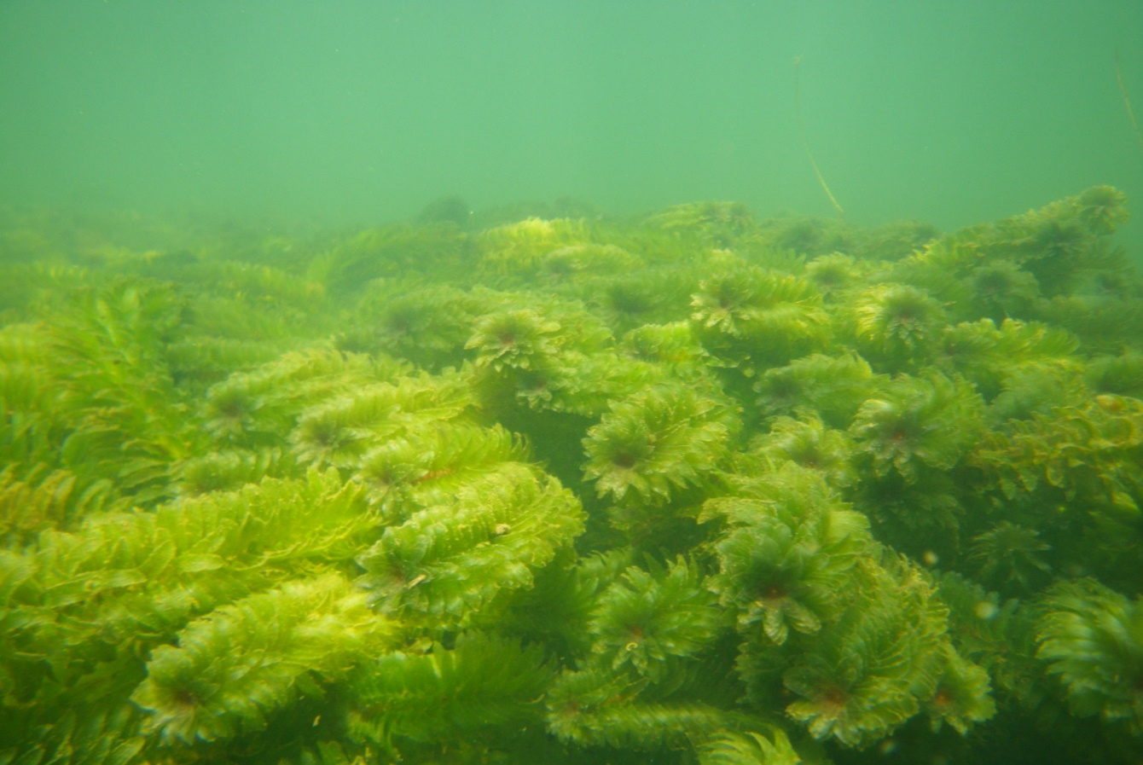
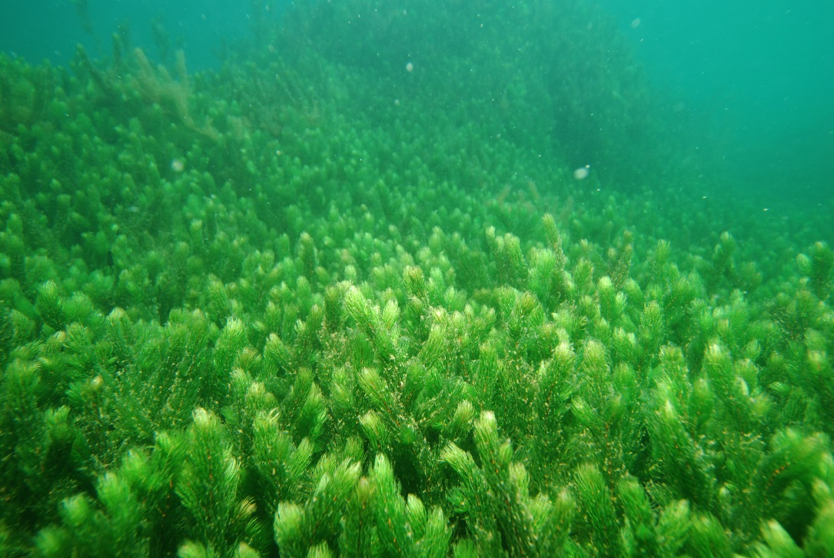
2. Rotorua lakes - introduced species
Egeria Hornwort

Slide 15
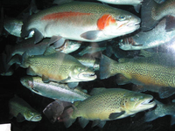
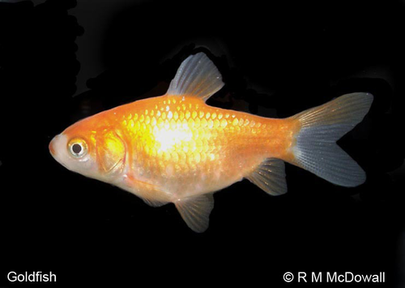
2. Rotorua lakes - introduced species
Salmonids Goldfish

Slide 16
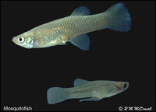
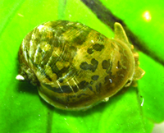
2. Rotorua lakes - introduced species
Gambusia Ear pond snail

Slide 17
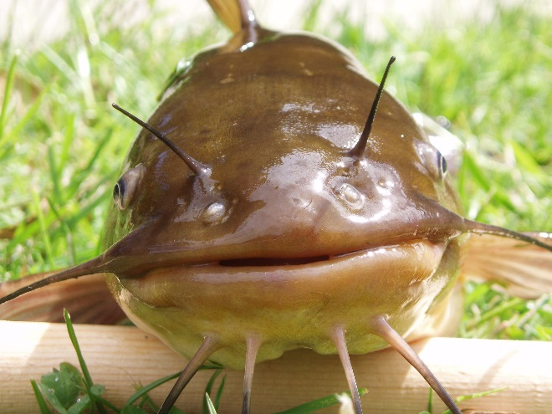
2. Rotorua lakes - introduced species
First record – DOC
2009 Okawa Bay, dead
2015 Hot pool owners report
2016 Te Weta Bay
weed harvester capture
Brown bullhead catfish

Slide 18
3. Distribution of submerged weeds
Lake | Lagarosiphon | Egeria | Hornwort
Rotokakahi
Ōkaro
Rotomā | u
Tikitapu | u
Ōkataina | u |  | u
Ōkāreka | u | u | u
Rerewhakaaitu | u | u
Rotomāhana |  | u | u
Rotorua | u | u | u
Tarawera | u | u | u
Rotoiti | u | u | u
Rotoehu | u |  | u

Slide 19
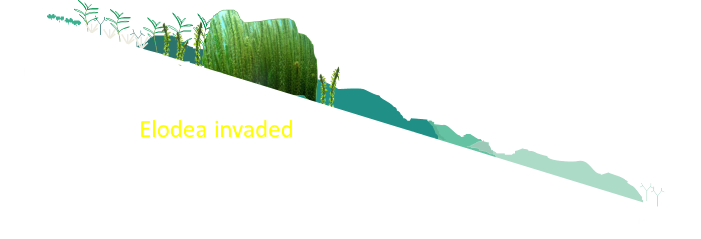
Lake Tarawera – 1930’s

Slide 20
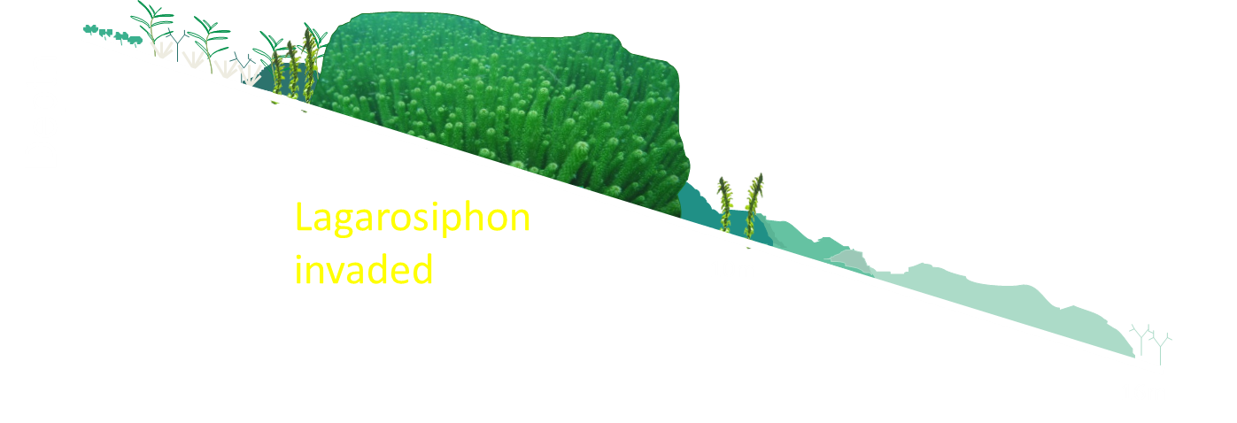
Lake Tarawera – 1970’s
Notes:
For some lakes Egeria might have invaded next. Key to note that aquatic weeds have differing degree of impacts.

Slide 21
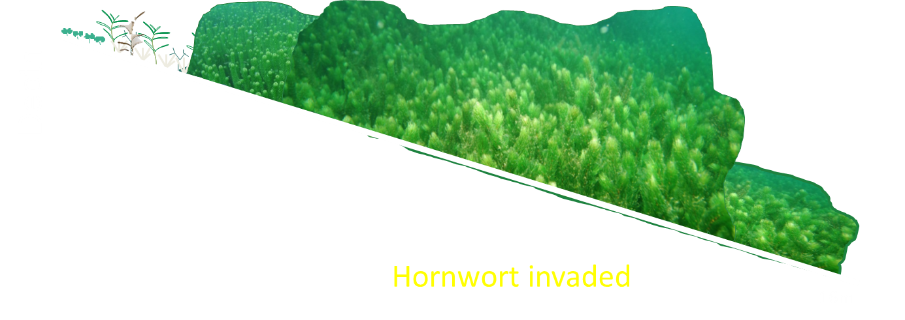
Lake Tarawera – 1990’s
Notes:
Hornwort first recorded in Lake Tarawera in 1988 and by mid 1990’s had spread around most of the lake and doubled the maximum depth of invasive plant growth. By 2005 hornwort was responsible for the widespread displacement of almost all former deep water charophyte meadows.

Slide 22
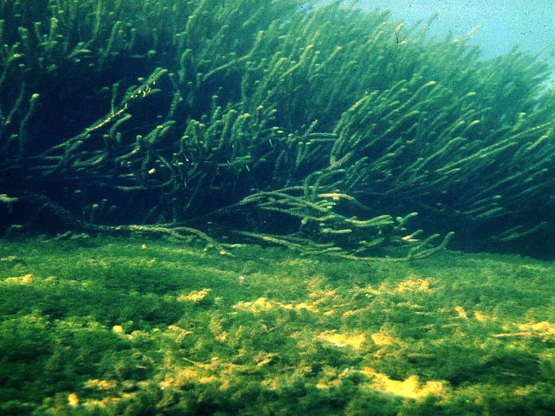
4. Impacts
Displaces native plant communities
Buries native seed banks
Notes:
[ As well as smothering out our native plant communities, dense invasive weed growth can restrict the movement of water, cause flooding, block irrigation and drinking water intakes, clog hydro dam intakes, destroy habitats for native fish and wildlife, decrease water quality and can restrict recreational activities such as boating, fishing and swimming. ]

Slide 23
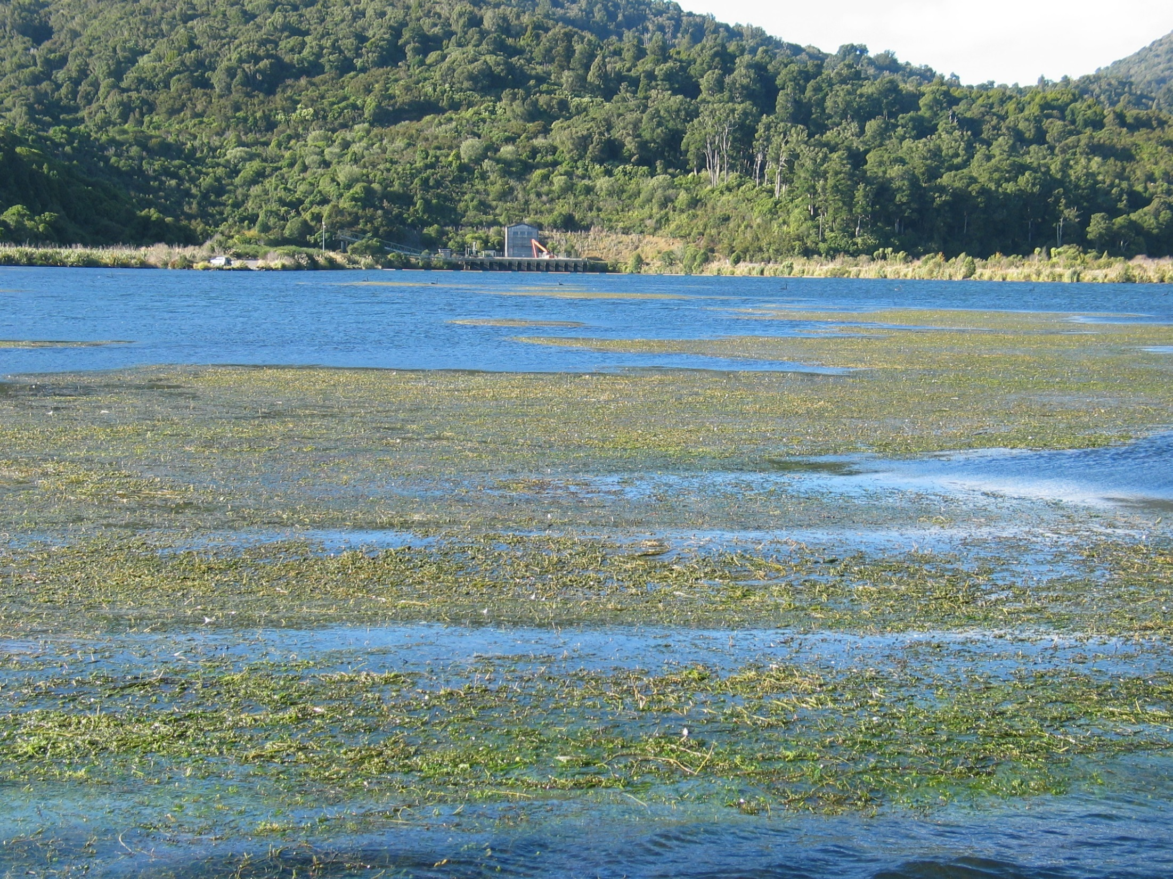
4. Impacts
Restrict water movement – cause flooding
Block irrigation and drinking water pumps
Notes:
Large amounts of weed can restrict water movement (cause flooding) and block irrigation and drinking water pumps.

Slide 24
4. Impacts
Destroy habitats for native fish and wildlife
Degrades sediment properties (no koura or kakahi)
Degrades water quality (DO & pH)
Notes:
Base of weed beds virtual deserts with highly flocculant sediment, too loose to support fw mussels or koura, deoxygenated especially during night.

Slide 25
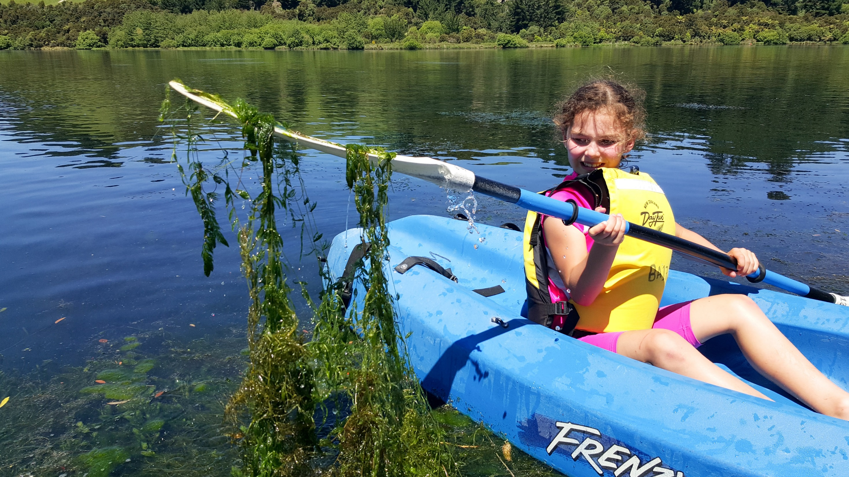
4. Impacts
Interferes with recreational activities
Notes:
And above the surface weeds can restrict recreational activities such as boating, fishing and swimming.

Slide 26
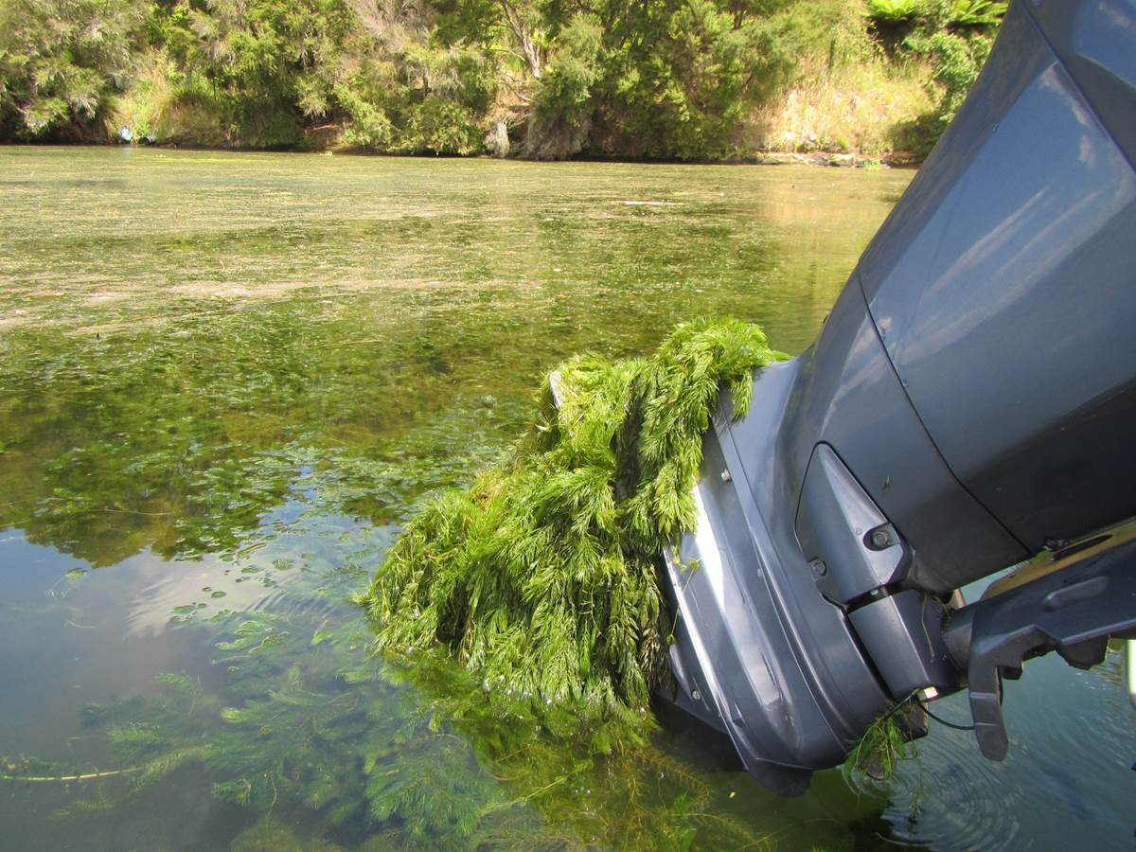
4. Impacts

Slide 27
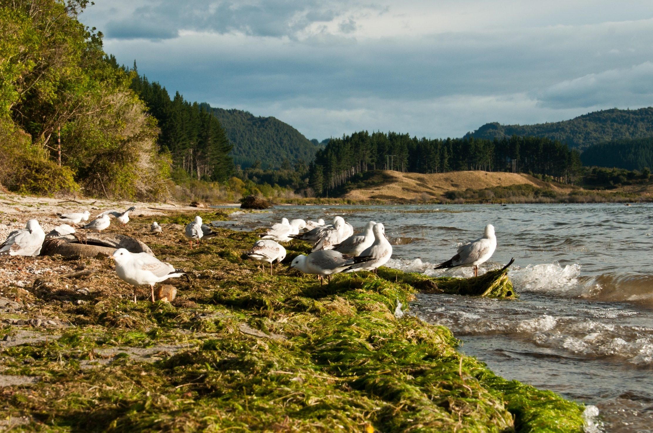
4. Impacts
Notes:
Rotting and smelling weed on the foreshore. Not how we want visitors and tourists to remember their visit to the lakes.

Slide 28
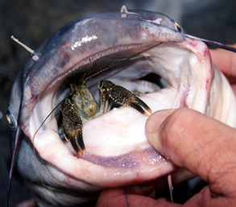
4. Impacts
Predation on native fish and invertebrates
Competition for food
Decline in water quality/clarity
Disturbance of sediments/plants
Champion et al. (2002)

Slide 29
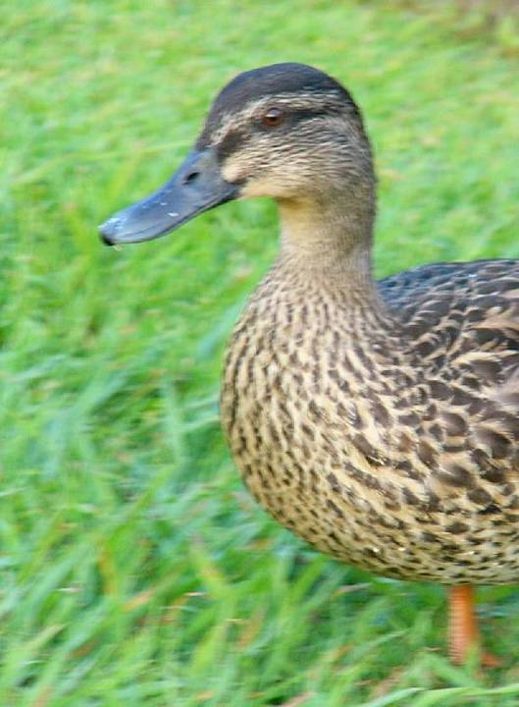
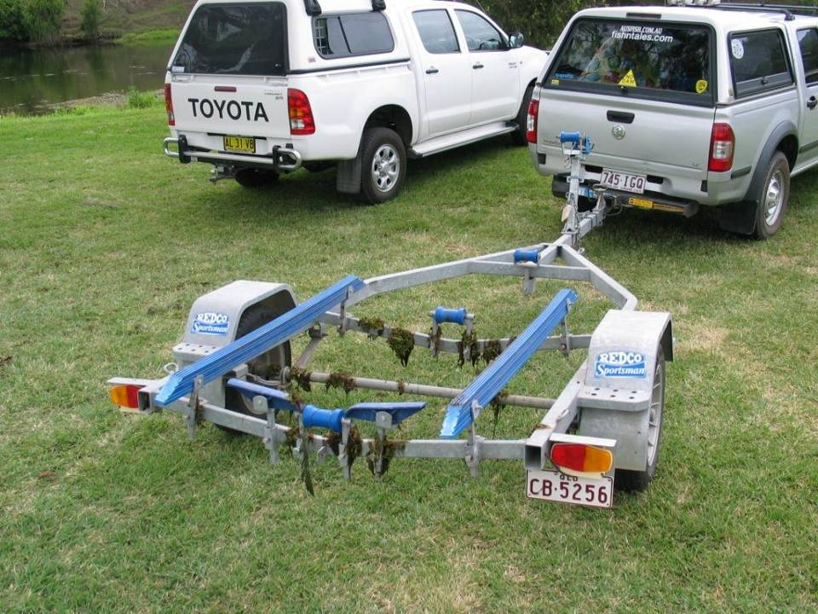
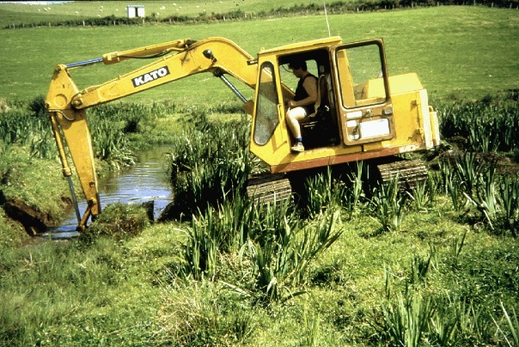
5. Dispersal
Natural spread – seed production and adaptation for spread
Recreational craft – trailers, anchor wells, jet motors
Fishing nets – especially fyke nets, mullet nets
Contaminated diggers and harvesters
Coarse fishermen
Aquarium liberation
Deliberate spread
Notes:
Rotting and smelling weed on the foreshore. Not how we want visitors and tourists to remember their visit to the lakes.

Slide 30
6. Management
Poor dispersal between water bodies
Spread to new sites through human activities
Virtually no barrier to spread once introduced, spread by fragmentation
Fish need to successfully reproduce, slower establishment
Problem identifying new infestations early
Few available control/eradication techniques
Therefore good candidates for pro-active management

Slide 31
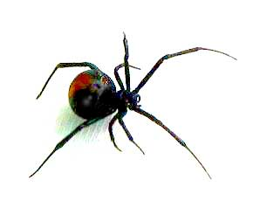
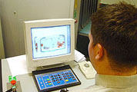
6. Management at the border
Hazardous Substances and New Organisms Act (1996)
No new aquatic spp. imported (< 50 plant spp. in total)
Biosecurity Act (1993)
Inspection at ports and soft x-ray of all mail items
PEQ

Slide 32
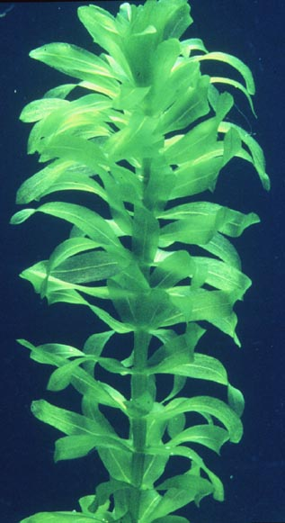
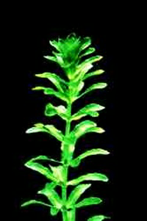
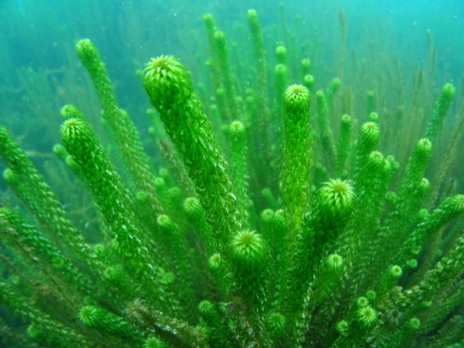
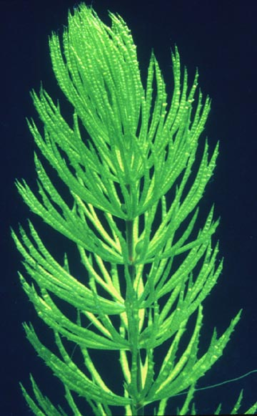
6. Manage introduction/dispersal pathways
Noxious Plant Act 1978
Class B species banned from sale and distribution (1982)
National Pest Plant Accord 2002 (Biosecurity Act)
~30 aquatic plants declared Unwanted Organisms and banned from sale

Slide 33
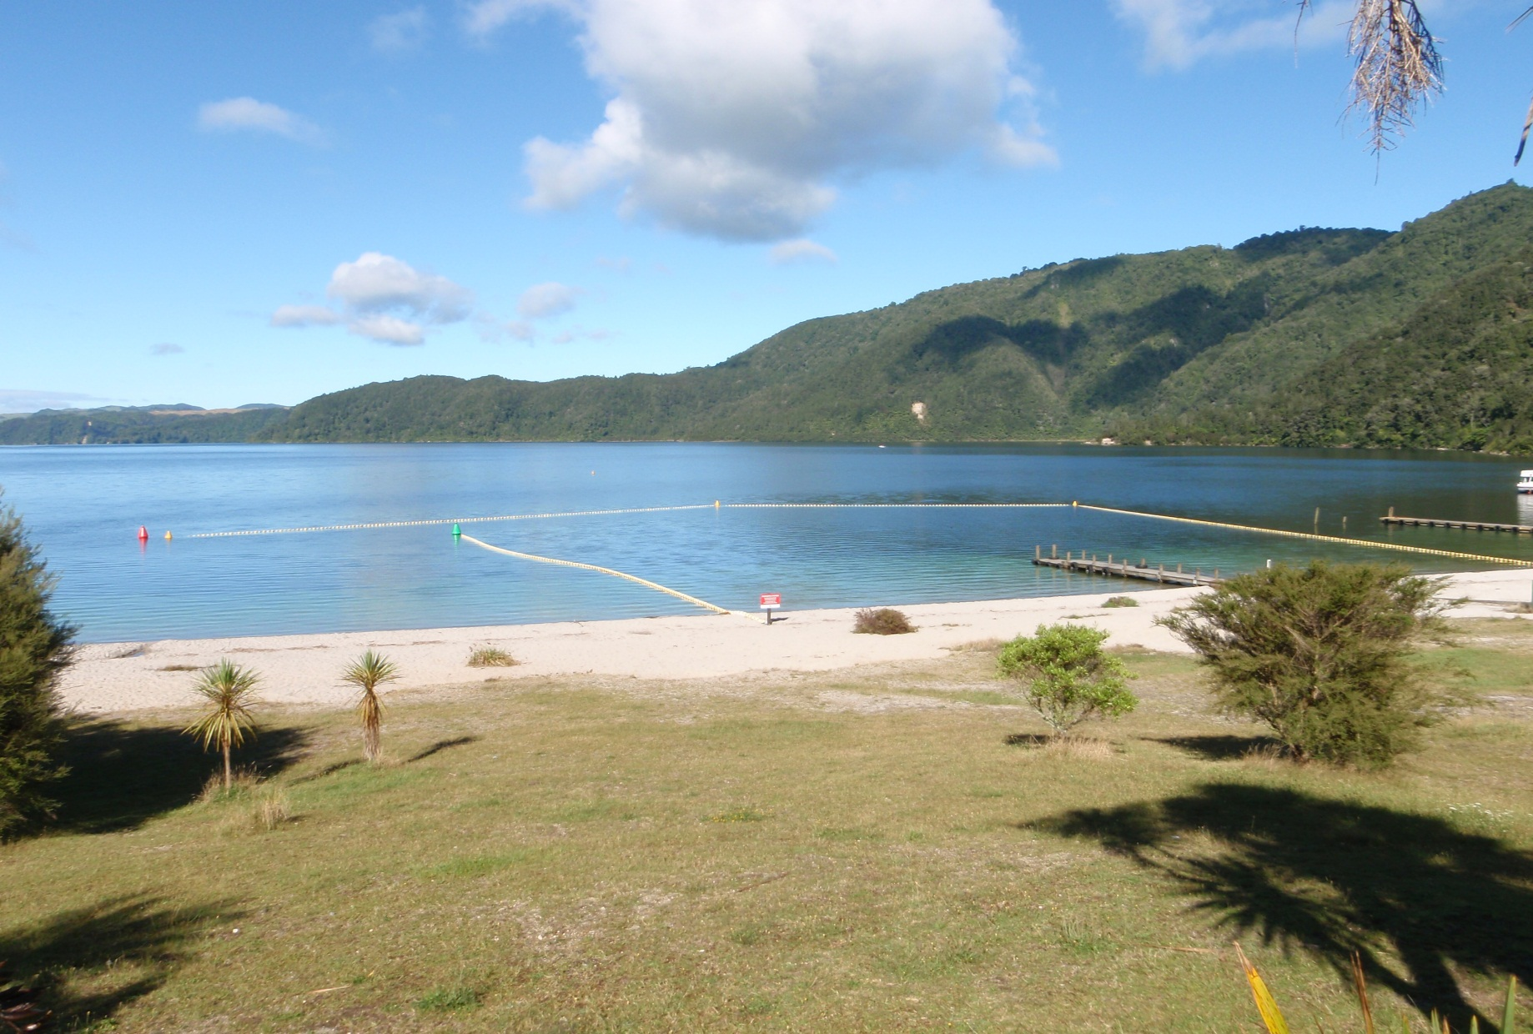
6. Surveillance
Lake Ōkataina weed cordon

Slide 34
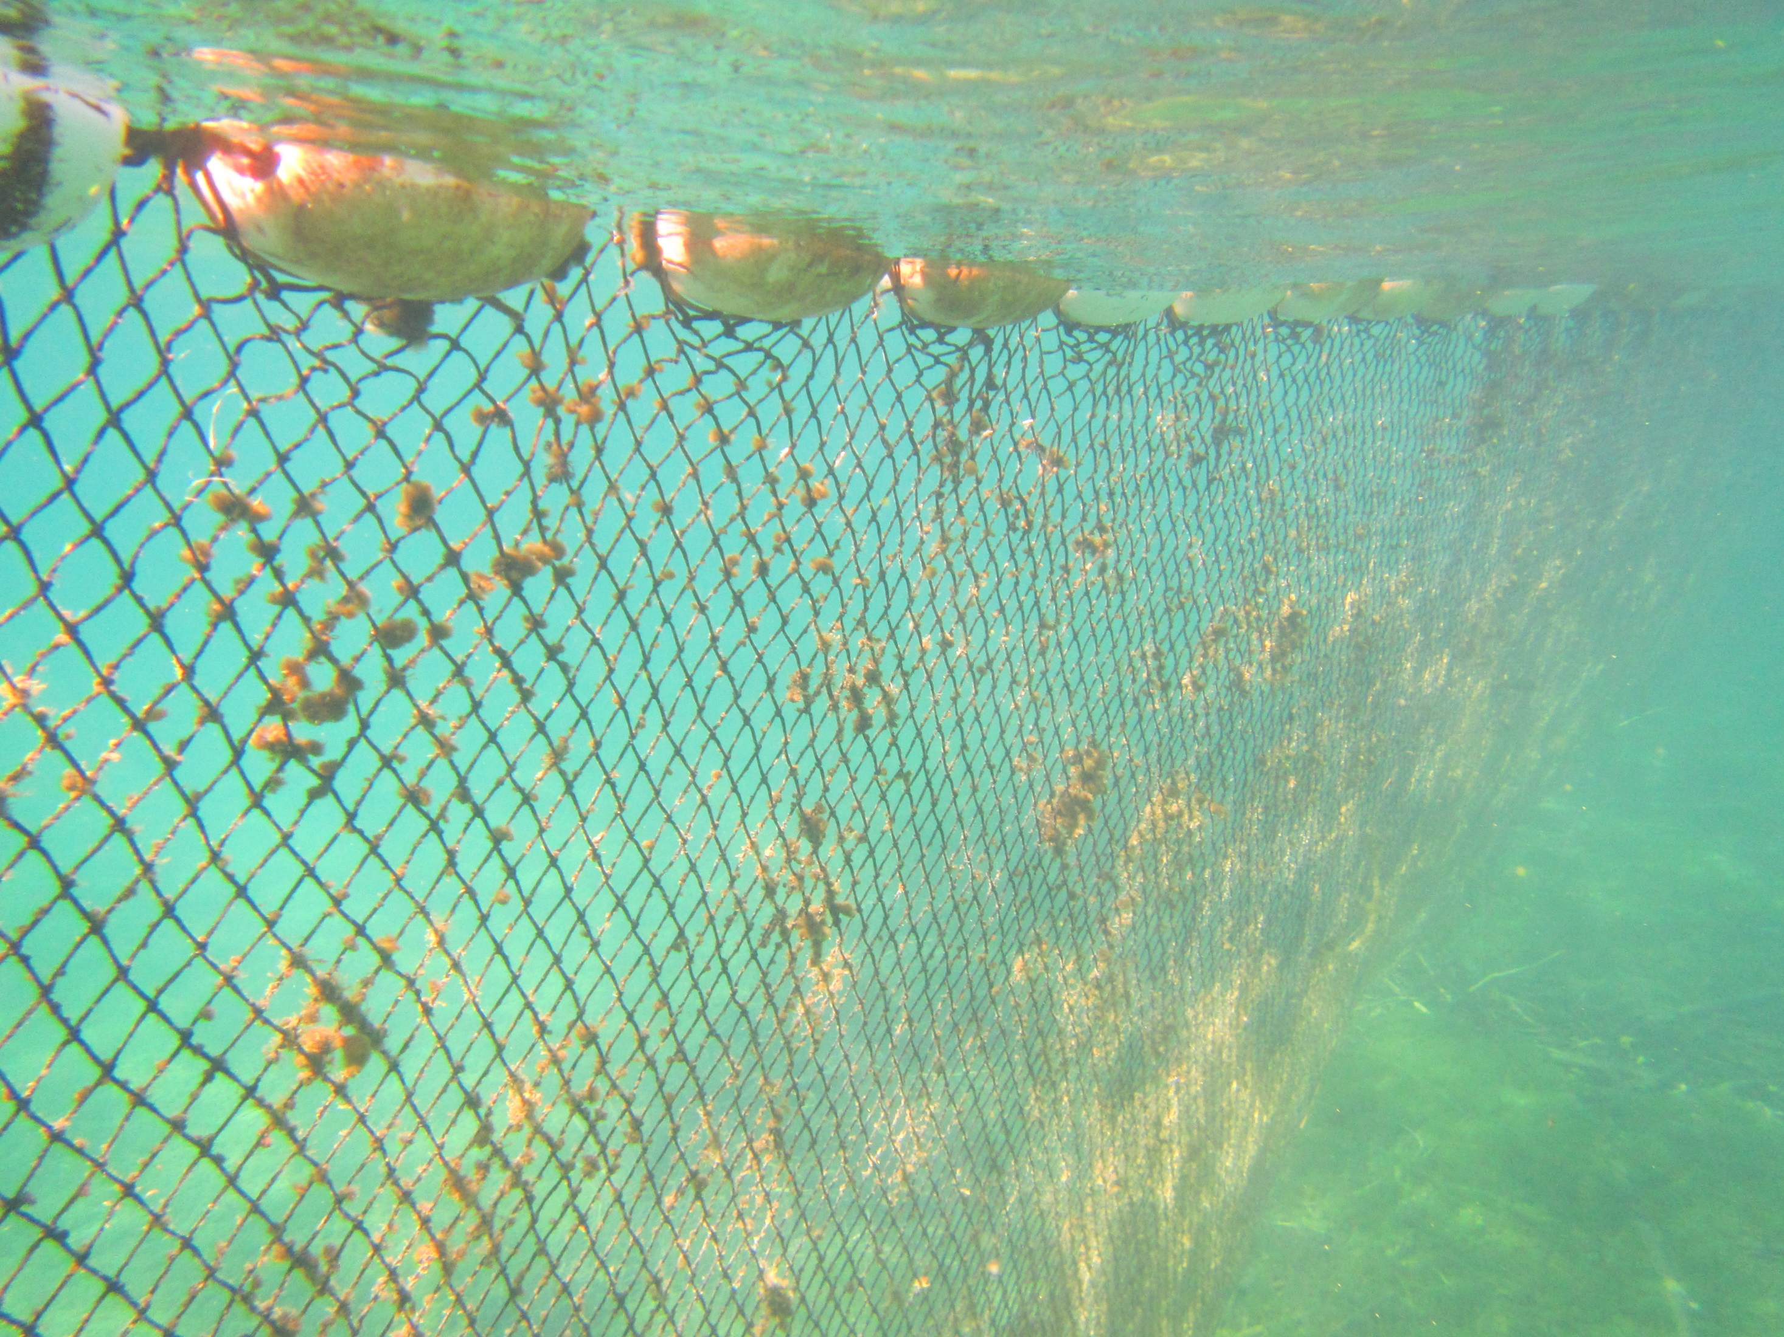
6. Surveillance
Lake Rotomā weed cordon

Slide 35
Acknowledgements
John Clayton, Rohan Wells, Mary de Winton, Deborah Hofstra
NIWA SSIF funding
Champion, P.D.; Clayton, J., Rowe, D. (2002). Lake Managers Handbook: Alien Invaders. MfE Report (https://www.mfe.govt.nz/sites/default/files/lm-alien-invaders-jun02.pdf)
de Winton, M.D.; Champion, P.; Elcock, S.; Burton, T.; Clayton, J. (2017). Informing management of aquatic plants in the Rotorua Te Arawa Lakes.
NIWA report to BOPRC
Wells, R.D.S.; de Winton, M.; Clayton, J. (1997). Successive macrophyte invasions within the submerged flora of Lake Tarawera, Central North Island, New Zealand, New Zealand Journal of Marine and Freshwater Research, 31: 449-459

